Slide 1





World Happiness And You
An insight into why countries are miserable or happy and how that can benefit you.

Slide 2
Happiness In The World
World Happiness Report
Annual happiness survey conducted since 2012
Our Data Set: 2015-2017
Overall Happiness Score ranked on a 0 (worst) – 10 (best) scale based on seven criteria :
Economy/GDP
Family Values
Health/Life Expectancy
Freedom
Generosity
Government Corruption
Dystopia Residual

Slide 3

Why Could This Possibly Be Important?
Observe Governing Styles
Major political implications
Policy decisions
Intergovernmental Relations
Progress of nations

Slide 4
What We Will Be Discussing Today
Principal Component Analysis
1
Factor Analysis
2
Cluster Analysis
3

Slide 5

The Output

Slide 6
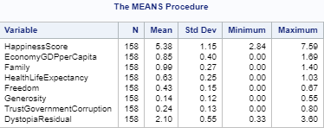
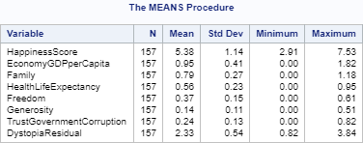
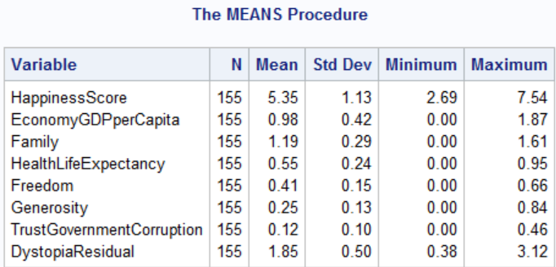
Means
2015
2016
2017

Slide 7
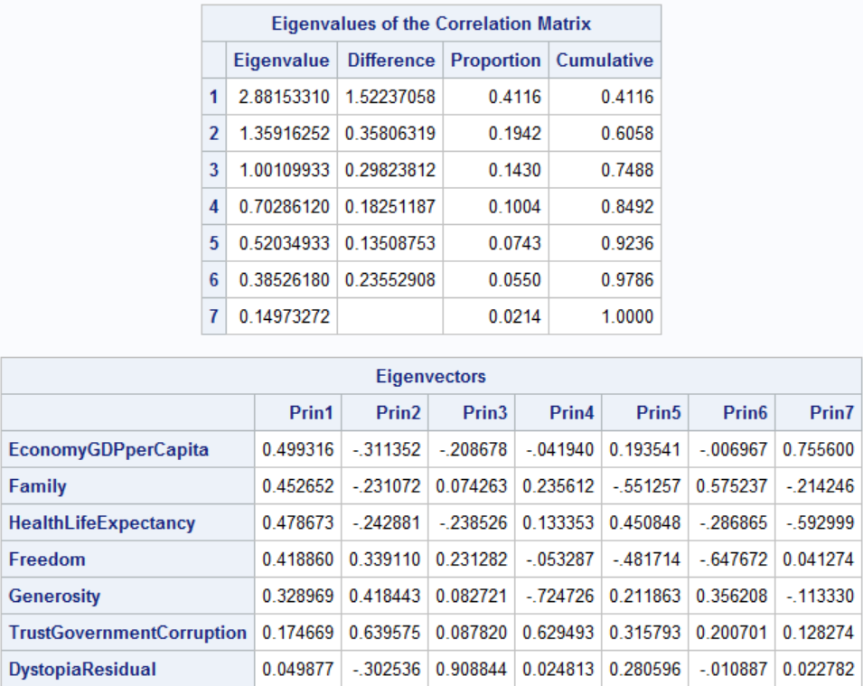
PCA
2015

Slide 8
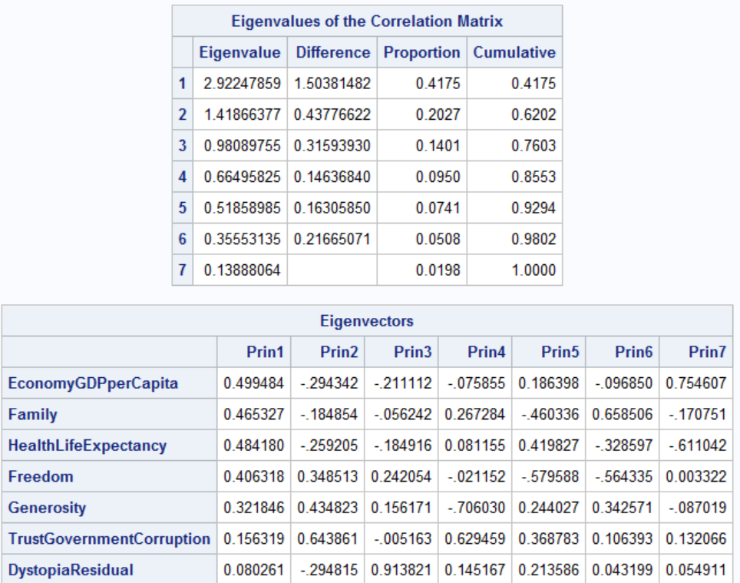
PCA
2016

Slide 9
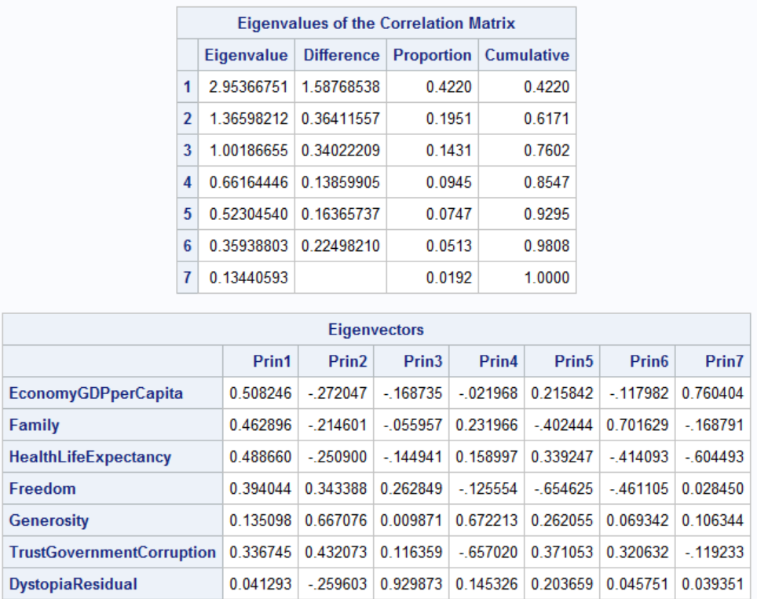
PCA
2017

Slide 10
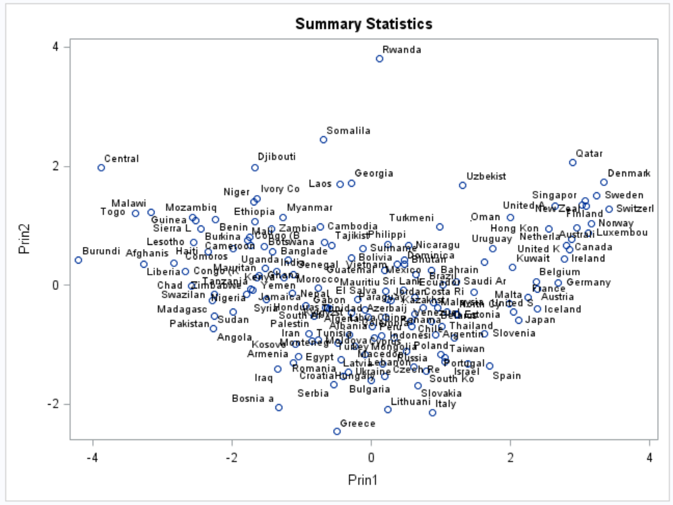
PCA
2015

Slide 11
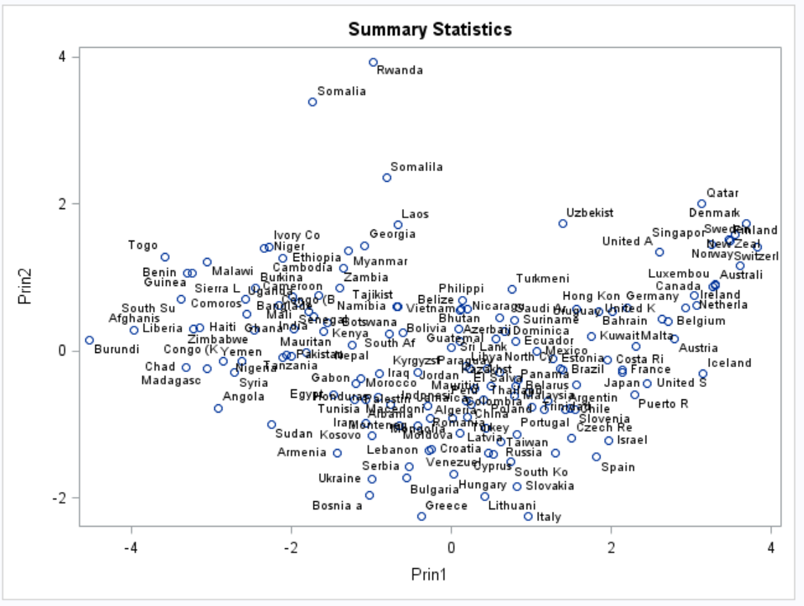
PCA
2016

Slide 12
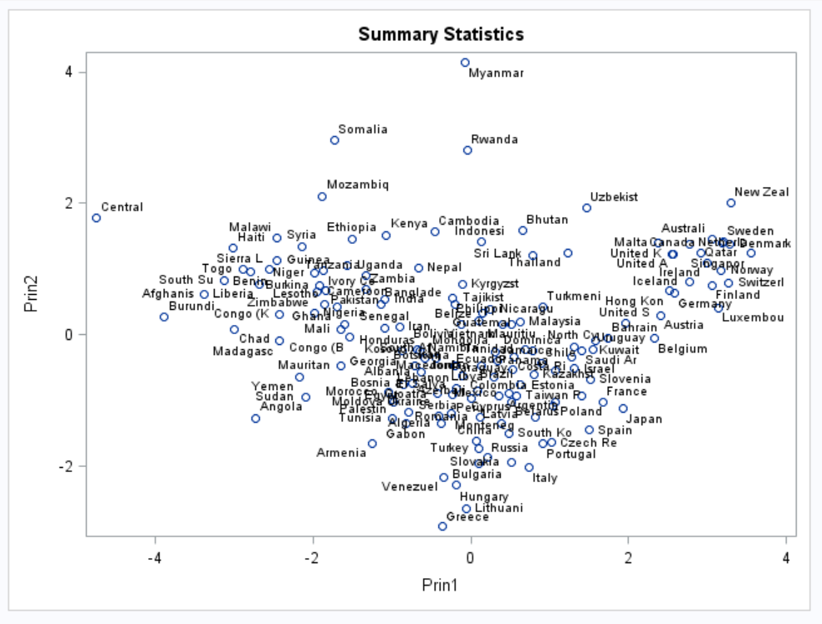

PCA
2017

Slide 13
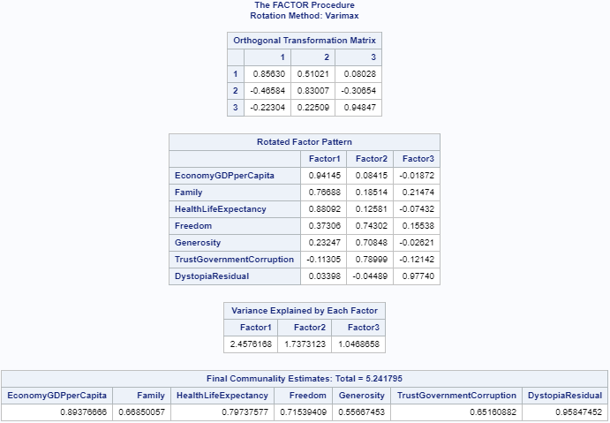
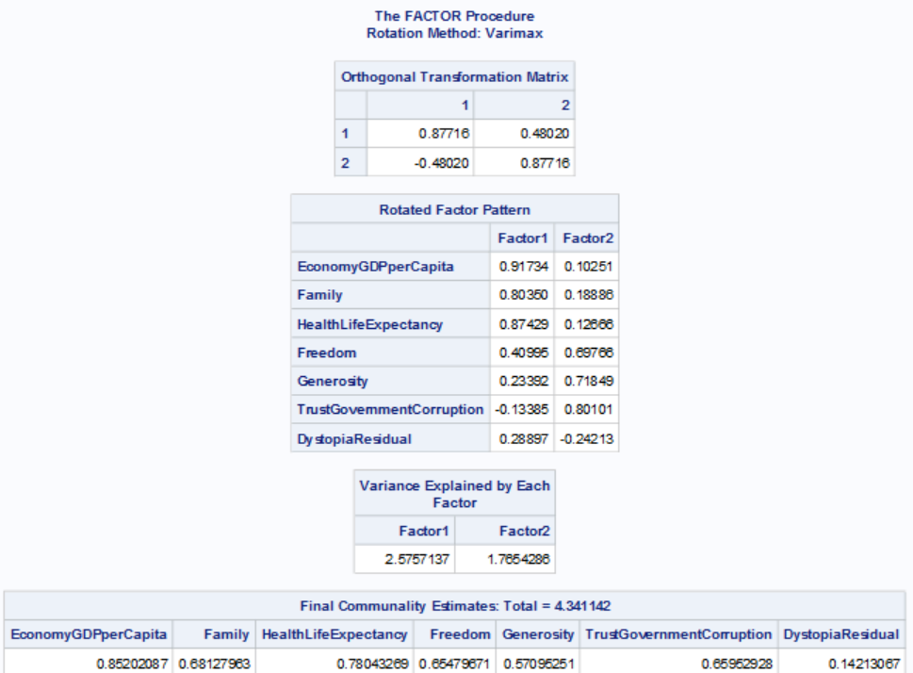
Factors
2015
2016

Slide 14
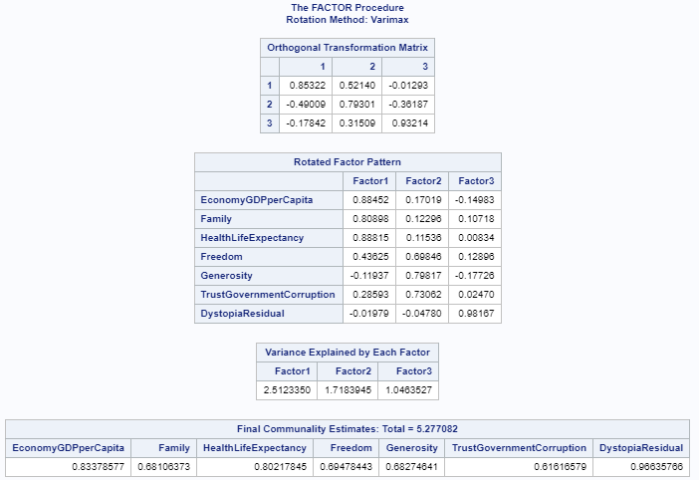
Factors
2017

Slide 15
Le Clusters
Single Linkage provided no helpful clustering
As many scores were similar, no real differences could be noted
Complete Linkage provided ability to show true differences between nations
Loadings are all weighted

Slide 16
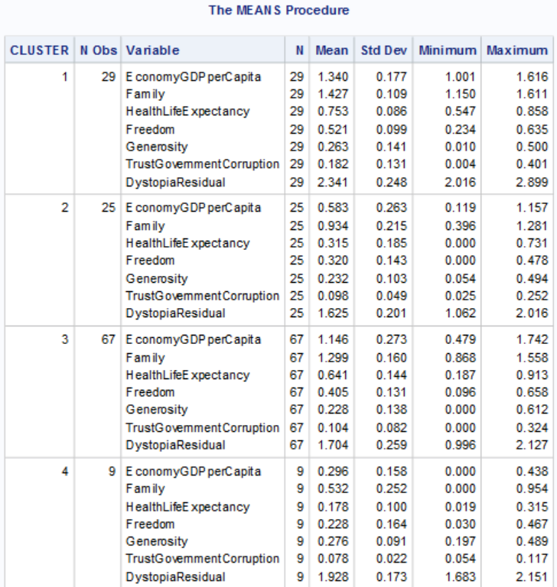
Le Clusters

Slide 17
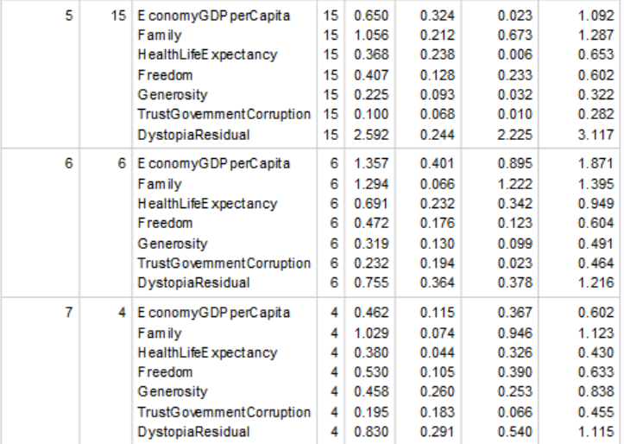
Le Clusters

Slide 18

Dem Rankings Doe!
Who is the happiest in the world?

Slide 19
World Rankings in 2015
The Top Happiest
Rank | Country | Overall Score
1 | Switzerland | 7.587
2 | Iceland | 7.561
3 | Denmark | 7.527
4 | Norway | 7.522
5 | Canada | 7.427
The Least Happiest
Rank | Country | Overall Score
154 | Rwanda | 3.465
155 | Benin | 3.34
156 | Syria | 3.006
157 | Burundi | 2.905
158 | Togo | 2.839

Slide 20
World Rankings in 2016
The Top Happiest
Rank | Country | Overall Score
1 | Denmark | 7.56
2 | Switzerland | 7.509
3 | Iceland | 7.501
4 | Norway | 7.498
5 | Finland | 7.413
The Least Happiest
Rank | Country | Overall Score
153 | Benin | 3.484
154 | Afghanistan | 3.36
155 | Togo | 3.303
156 | Syria | 3.069
157 | Burundi | 2.905

Slide 21
World Rankings in 2017
The Top Happiest
Rank | Country | Overall Score
1 | Norway | 7.537
2 | Denmark | 7.522
3 | Iceland | 7.504
4 | Switzerland | 7.494
5 | Finland | 7.469
The Least Happiest
Rank | Country | Overall Score
151 | Rwanda | 3.471
152 | Syria | 3.462
153 | Tanzania | 3.349
154 | Burundi | 2.905
155 | Central African Republic | 2.693

Slide 22

What Stayed The Same?
In The Happy Countries:
Successful economic policies
Good health
Families/Support Systems Valued
In The Unhappiest Countries
War/Conflict (Civil or International)
High Government Corruption
Health Crisis

Slide 23
What Changed?
Middle Of The Pack
Brazil, Greece, and Colombia dropped
The Philippines, Russia, and Palestine rose
France and China saw a dip then rise
Canada dropped closer to United States ranking

Slide 24

Why Did The Changes Occur?
World Events
2015
Stock Market Crash of China
France Terrorist Attacks
Greek Economic Collapse
Spain Political Deadlock
2016
US Presidential Election
North Korea Nuclear Tests
TPP Failure
Zika Virus
2017
Rohingya Crisis in Myanmar
The Fall of Mosul
Beginning of Recovery from The Great Recession
Rise of Xi Jinping

Slide 25
In Conclusion
What we learned:
First world countries score highest
Third world or corrupt countries score lowest
Global events impact scores
Events in one country affect neighboring countries
Effect on international business relations
Be like Western Europe

Slide 26
Be Excellent To Each Other!

